Slide 1
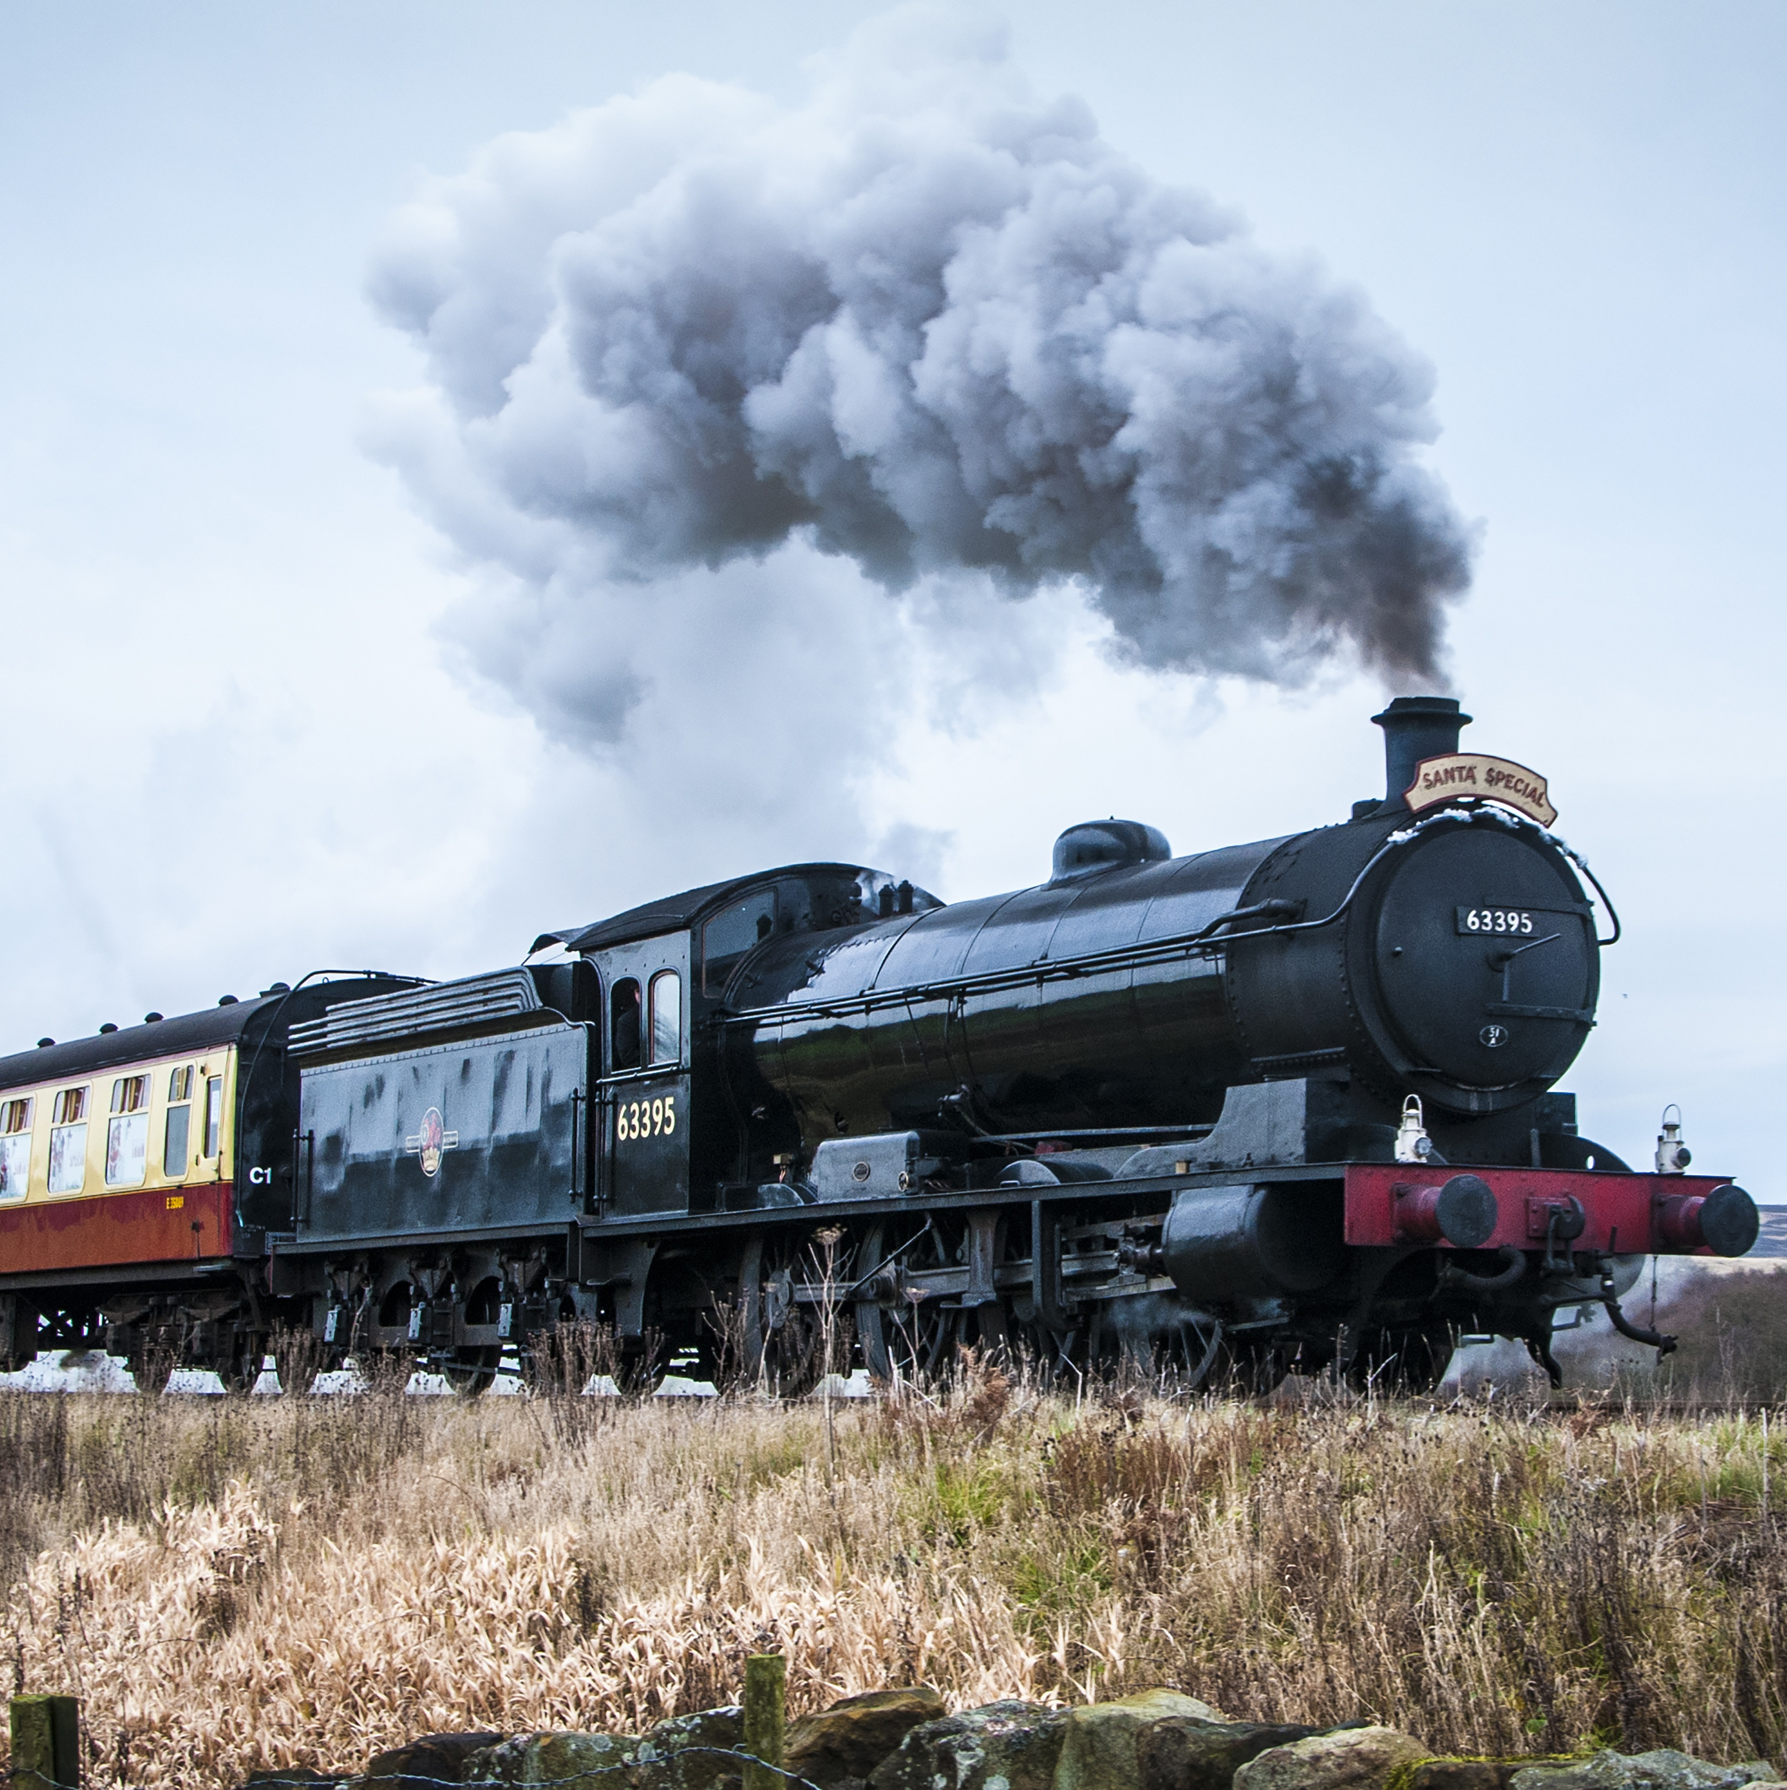
Train Ticket Reservation
Project by:
Bhagwati Tiwari
Harsh Kumar
Akshat Singhai
Murali Arandala
Swapnil Deokar

Slide 2
CONTENTS
Introduction
Problem Statement
Design/Architecture
Technologies Used
Screenshots

Slide 3

INTRODUCTION
This system is basically concerned with the reservation of Railway tickets to the passengers.
In this we are discussing that how reservation is done.
What are the rules & regulations and procedure for reservation.

Slide 4




Problem Statement
Create a train ticket reservation application using spring boot with java/MySQL/html/CSS/.
Where user can login and book the ticket.
Where Admin can Add/delete and Edit the Database.

Slide 5
ARCHITECTURE

Slide 6

TECHNOLOGIES USED
Spring Boot
Heidi SQL Database
Java
HTML
CSS
Java Script
Bootstrap

Slide 7
SCREENSHOTS

Slide 9

THANK YOU

